Slide 1

AMAZON CUSTOMER REVIEW

Slide 2
BUSINESS UNDERSTANDING:
Amazon is a global e-commerce and technology company, founded by Jeff Bezos in 1994. Initially focused on online book sales, it has since expanded into various sectors including retail, cloud computing (AWS), artificial intelligence, streaming (Amazon Prime Video), and logistics. Amazon is known for its customer-centric approach, innovative technologies, and vast product selection. It operates worldwide, with its core business encompassing e-commerce, Amazon Web Services (AWS), and devices such as Kindle and Alexa. Amazon also has a significant presence in the entertainment, electronics, Accessory, Smart home and healthcare industries. The company continues to drive advancements in automation, cloud services, and digital infrastructure.
Our focus with the amazon market in e-commerce is the customer reviews. In the online market of today, customer reviews were an essential part of purchasing decisions. Amazon, being a giant online store, collects millions of product reviews that indicate customer satisfaction, product quality, and overall user experience. It is not efficient, however, to process such vast data manually and is time-consuming.
Sentiment analysis enables companies to analyze customers' feedback automatically, extract meaningful information, and make knowledgeable input.

Slide 3
PROBLEM STATEMENT:
Amazon gets millions of reviews; it faces the challenge of processing vast amounts of text data efficiently. Manually reading and analyzing each review is impractical. This is where automated sentiment analysis comes into play. By leveraging Natural Language Processing (NLP) and machine learning algorithms, Amazon can categorize reviews as positive, negative, or neutral.
This automated system can quickly sift through large volumes of customer feedback, providing businesses with insights into customer satisfaction, product performance, and emerging trends. Sentiment analysis not only helps businesses understand the emotional tone of reviews but also aids in identifying key themes and areas for improvement, ultimately enhancing the customer experience and driving better decision-making

Slide 4
BUSINESS OBJECTIVES:
Main Objectives:
To accurately determine the overall emotional tone (positive, negative, or neutral) of customer reviews.
Specific Objectives:
Identify trends in customer satisfaction.
Improve customer experience by addressing negative feedback.
Help businesses optimize their product offerings based on user sentiment.

Slide 5
Key Business Questions
What percentage of customer reviews are positive, negative, or neutral?
Are there specific features or keywords associated with reviews?
Can sentiment analysis help predict potential or customer dissatisfaction?
Can the business use sentiment insights to improve product quality and customer support?

Slide 6
Metric of Success
Technical Success Metrics:
These metrics assess the performance of your machine learning models in terms of accuracy, reliability, and scalability.
Model Performance Metrics:
Accuracy:
Measures the overall correctness of the model’s predictions. Higher accuracy indicates better classification. We aim to achieve an accuracy of 85% and above
Precision, Recall, and F1-score:
Precision: Measures how many predicted positive sentiments are actually positive.
Recall (Sensitivity): Measures how well the model identifies all positive sentiments.
F1-score: Harmonic mean of precision and recall; balances false positives and false negatives.

Slide 7
CONT…
Business Success Metrics:
These metrics determine the impact of the sentiment analysis system on business outcomes.
1. Customer Experience & Retention:
Increase in Customer Satisfaction: A rise in positive sentiment over time indicates improved customer experience.
Decrease in Negative Reviews: A reduction in complaints suggests that business improvements align with customer expectations.
Improved Response Time: Faster identification of negative reviews enables quicker customer service interventions.
2. Revenue & Sales Impact:
Higher Product Ratings & Sales Growth: Positive sentiment correlates with increased sales and product trust.
Reduction in Return Rates: Fewer negative reviews and complaints may indicate improved product quality, reducing return rates.
Customer Retention Rate: If sentiment analysis helps address concerns proactively, retention should increase.
3. Operational Efficiency
Automation of Review Analysis: Reduces manual effort in sorting and responding to reviews.
Enhanced Decision-Making: Insights from sentiment trends guide product improvements and marketing strategies.

Slide 8
DATA UNDERSTANDING
The dataset used for this sentiment analysis project consists of Amazon product reviews, which provide insights into customer opinions about various products. It contains 1,597 records with 27 columns, capturing details about the product, review content and user feedback.

Slide 9
Column names:
id → Unique identifier for each review.
asins → Amazon Standard Identification Number (ASIN) of products
brand → Brand of the product.
categories → Product categories (e.g., "Amazon Devices").
colors → Available colors of the product (often missing).
dateAdded → Date the review was added to the dataset.
dateUpdated → Date the review was last updated.
dimension → Physical dimensions of the product.
manufacturer → Manufacturer of the product.
manufacturerNumber → Manufacturer’s product number.
name → Product name.
prices → Pricing details of the product.
reviews.date → Date when the review was posted.

Slide 10
Cont..
reviews.doRecommend → Whether the reviewer recommends the product
reviews.numHelpful → Number of users who found the review helpful.
reviews.rating → Star rating given by the reviewer (1 to 5).
reviews.sourceURLs → URL of the original review page.
reviews.text → Full text of the review (Main feature for sentiment analysis).
reviews.title → Title of the review (Summary of the review).
reviews.username → Username of the reviewer.
reviews.userCity → City of the reviewer (Mostly missing).
reviews.userProvince → Province of the reviewer (Mostly missing).
sizes → Available sizes of the product (Mostly empty).
upc → Universal Product Code (UPC).
weight → Weight of the product.

Slide 11
DATA PREPARATION
This phase involves transforming raw data into a structured and clean format suitable for modeling. This step ensures that the dataset is free from inconsistencies, missing values, and unnecessary variables while preparing it for machine learning and deep learning algorithms.

Slide 12
Data cleaning
This is the process of cleaning the dataset by:
Dropping unnecessary columns
Checking and dealing with missing values
Dropping the duplicates
Changing the columns names format
Checking for outliers

Slide 13
Feature Engineering
Feature engineering is crucial for improving model accuracy and interpretability also assists in exploratory data analysis. In this project, the goal is to extract meaningful insights from the available features and create new ones that enhance the model's predictive power.
The feature engineering done for this project are:
Converting date format to MM-YY-DD
Mapping categories column to three distinct categories
Distributing the reviews.rating column into three distinct categories

Slide 14
Text Preprocessing for NLP analysis
Text preprocessing in NLP involves several steps to clean and transform the raw text into a format suitable for analysis. The key steps include:
Lowercasing – Convert all text to lowercase to ensure uniformity.
Removing Punctuation & Special Characters – Eliminates unnecessary symbols that do not contribute to meaning.
Tokenization – Splitting text into individual words or sentences.
Stop word Removal – Removing common words (e.g., "the," "is") that don’t add much value.
Lemmatization – Converting words to their base or root form (e.g., "running" → "run").

Slide 15
Sentiment Analysis Conversion
Here we determined the emotional tone of a given text by classifying it as positive, negative, or neutral using a sentiment analyzer. It will help analyze product reviews, extract insights about public opinion and sentiment trends of the products.
For this project the sentiment analyzer will identify the polarity i.e positive, negative and neutral.

Slide 16
Exploratory Data Analysis (EDA)
For this phase we will make visualizations that will help evaluate and analyze our business objectives and answer our business questions.
Visualizations crucial for this particular EDA include
Histplot
Countplot
Donutplot
Piechart
Stacked barplot
Barplot
Lineplot
Steps to follow include:
Univariate Analysis
Bi-variate Analysis
Multivariate Analysis

Slide 17
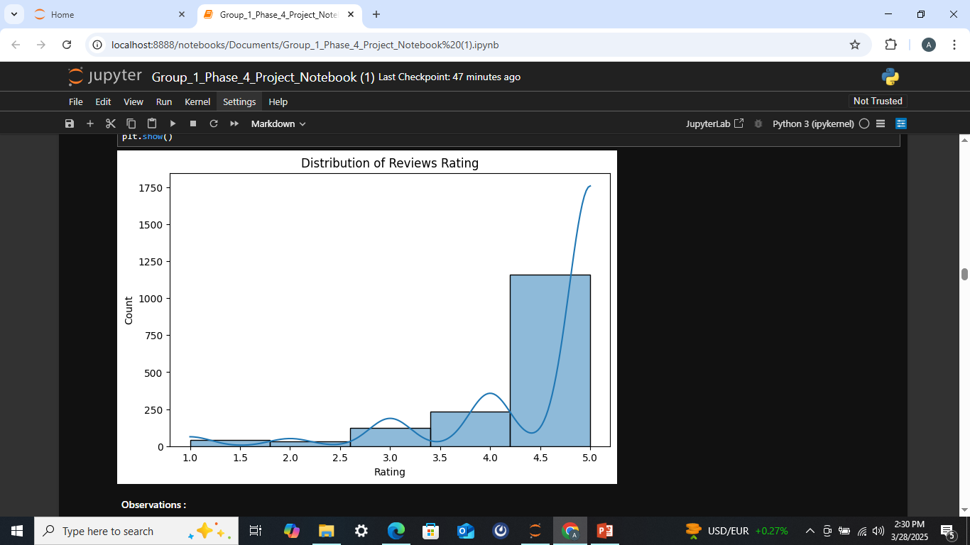
Univariate Analysis
Observations :
Right-Skewed Distribution: The majority of reviews have higher ratings (4 and 5). This indicates that most customers had a positive experience.
Fewer Low Ratings: Very few reviews fall in the 1 to 3 rating range. This suggests that negative feedback is rare

Slide 18
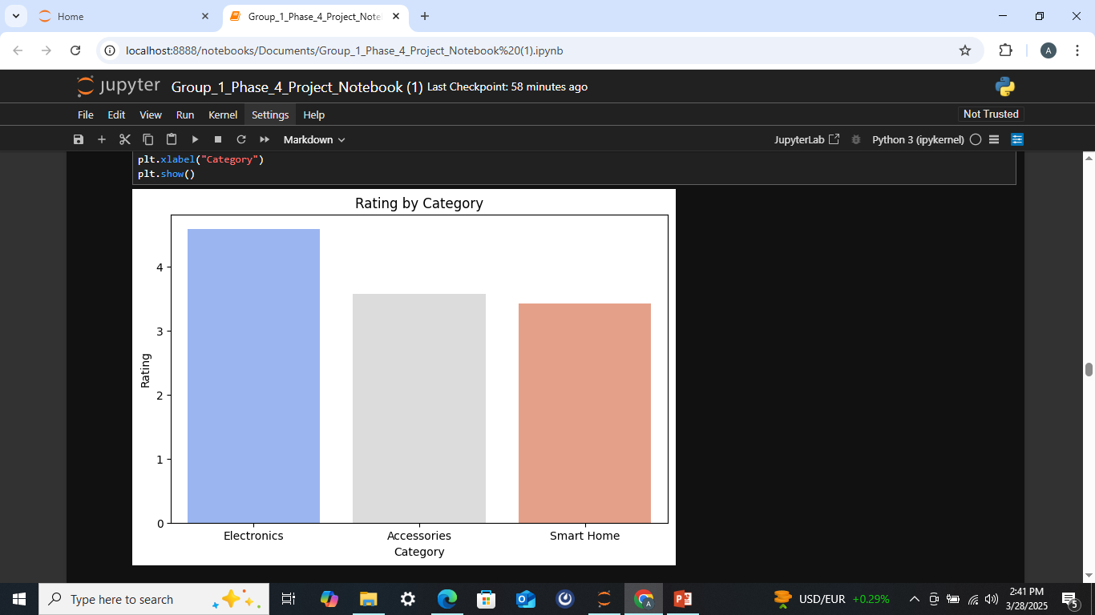
Bi-variate Analysis
Observations:
Electronics have the highest average rating, suggesting strong customer satisfaction, likely due to product quality and performance.
Accessories receive a moderate rating, indicating mixed feedback, possibly due to variability in product utility or durability.
Smart Home products have the lowest rating, implying customer concerns, which could be related to usability, compatibility, or reliability issues.

Slide 19
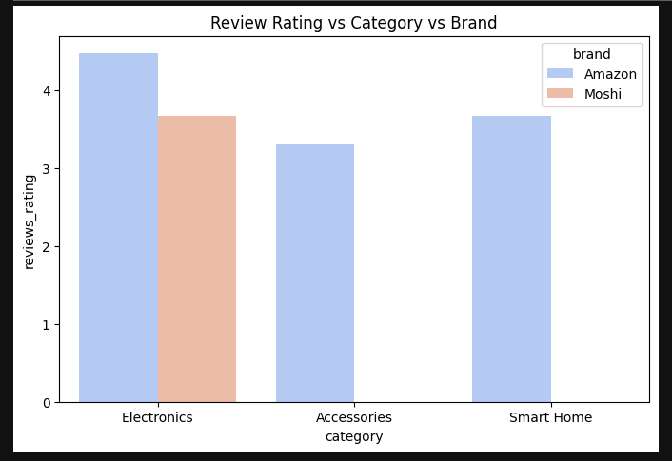
Multi-variate Analysis
Observations
Amazon Dominates in Ratings: Amazon consistently receives higher average review ratings than Moshi across all three categories (Electronics, Accessories, Smart Home).
Electronics Have Highest Ratings: Both Amazon and Moshi have their highest average review ratings in the Electronics category.
Accessories Have Lowest Ratings: Accessories show the lowest average review ratings for both brands, indicating potential challenges or customer dissatisfaction in this category.
Moshi's Performance Varies: Moshi's performance is more varied across categories, with a noticeable drop in ratings for Accessories and Smart Home compared to Electronics.

Slide 20
MODELING
We did the modeling process by developing multiple models and assess the best model for this classification problem based on the performance of each model. The models are the traditional machine learning models as base models and the deep learning which use neural networks. The models to build were:
Logistic regression model
Support Vector Machine
Recurrent Neural Network with Long-Term-Short Memory (LSTM)

Slide 21
Machine Learning Model
The best ML models for this business problem are the logistic regression and Support Vector Machine models.
We achieved the best models for each by handling class imbalance and hyperparameter tuning

Slide 22
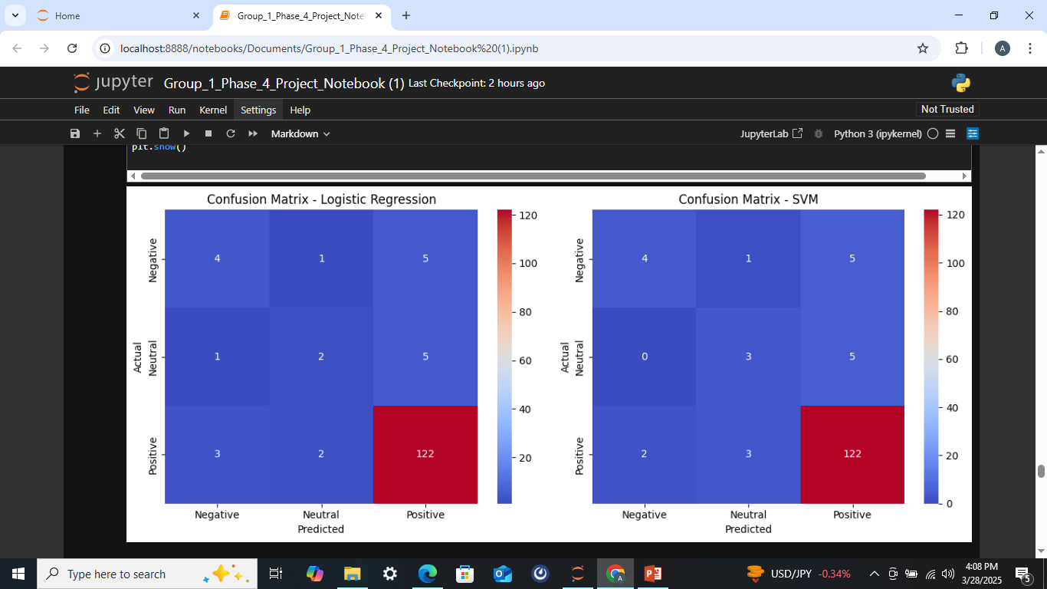
Confusion Matrix Analysis for the Machine Learning models:
Logistic Regression:
True Positives (Positive Sentiment): 122 correctly classified as positive.
False Negatives (Positive misclassified): 3 classified as negative, 2 as neutral.
False Positives (Incorrect Positives): 5 negatives and 5 neutrals incorrectly classified as positive.
Neutral Class Weakness: Only 2 neutrals correctly classified; 1 misclassified as negative and 5 as positive.
SVM:
True Positives (Positive Sentiment): 122 correctly classified.
False Negatives (Positive misclassified): 2 classified as negative, 3 as neutral.
False Positives (Incorrect Positives): 5 negatives and 5 neutrals misclassified as positive.
Neutral Class Weakness: Only 3 neutrals correctly classified; 3 misclassified as positive.

Slide 23
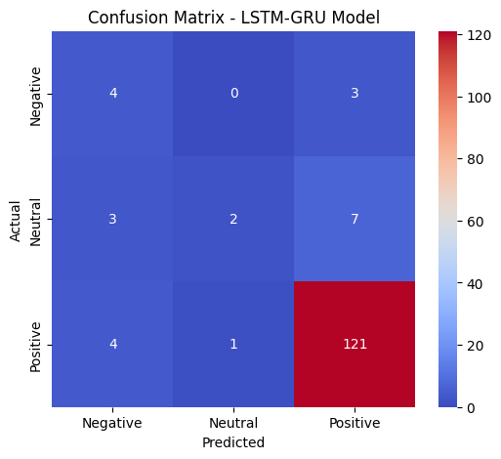
Deep Learning Model:
The deep model for this business problem was the Recurrent Neural Network (RNN) with LSTM.
Confusion Matrix Analysis:
Negative Class (Actual: Negative)
6 correctly predicted as Negative.
Neutral Class (Actual: Neutral)
3 correctly classified as Neutral.
Positive Class (Actual: Positive)
119 correctly classified as Positive.

Slide 24
MODEL DEPLOYMENT
We used the Streamlit applications for the model deployment and the steps are as follows:
Save the model first using keras before we begin the deployment
Install Required Dependencies i.e. Streamlit
Load the Trained Model and Tokenizer
Create the Streamlit App (app.py)
Run the Streamlit App Locally
Prepare for Deployment
Deploy on Streamlit Cloud

Slide 25
CONCLUSIONS
Most review ratings are 5 stars, indicating high customer satisfaction. For the ratings category, majority are "Excellent," with minimal negative reviews. Electronics dominate the product category while Accessories and Smart Home have fewer reviews. In Brands Amazon is more popular while Moshi has the least presence. Over 90% of reviews are positive; negative sentiment is minimal. Top Words in for Positive reviews highlight "Amazon" and "Kindle"; negative reviews mention "fire" and "tablet."
Customer ratings vary significantly across product categories, with Electronics receiving the highest average ratings, while Accessories and Smart Home products are rated lower. This suggests that customers generally find electronics more satisfactory compared to other categories.
Brand-wise, Amazon products receive notably higher ratings than Moshi, indicating stronger customer satisfaction and potentially better product quality, reliability, or brand trust associated with Amazon.
Sentiment analysis of review text and titles reveals a strong correlation between sentiment and ratings. Positive reviews are associated with the highest average ratings, neutral reviews receive moderately high ratings, and negative reviews have the lowest. This pattern confirms that customer sentiment in text and titles aligns closely with their given star ratings.
There is a clear dominance of positive sentiment in reviews over the years, with a notable spike in positive reviews around 2023. Negative and neutral sentiments remain consistently low, suggesting overall customer satisfaction. The significant increase in positive reviews in recent years warrants further investigation to understand the contributing factors
Finally, there is a clear dominance of the "Electronics" category in terms of count over the years, with a significant spike around 2023. "Accessories" show a low but consistent presence, while "Smart Home" has only a few occurrences towards the end of the timeframe. The dramatic increase in "Electronics" in 2023 warrants further investigation to understand the contributing factors to this surge.
The best model was a deep learning model the Balanced Recurrent Neural Network Model which was saved and deployed for future use.It achieved an accuracy of above 85% with balanced precision and recall tradeoff. This was caused by the high class imbalance. The dataset contained more positive sentiments than even neutral and negative ones. After numerous attempts the imbalanced was somehow balanced though not perfectly.

Slide 26
RECOMMENDATIONS
1. Leverage High Customer Satisfaction for Brand Growth
Since most review ratings are 5 stars and the majority of reviews fall under the "Excellent" category, the company should highlight these positive reviews in marketing campaigns. Testimonials and ratings can be showcased to reinforce trust and attract new customers.
2. Enhance Customer Experience for Lower-Rated Categories
Electronics receive the highest ratings, while Accessories and Smart Home products have lower ratings. The company should investigate customer concerns in these categories by analyzing negative reviews and improving product quality, features, or pricing strategies.
3. Improve Moshi’s Brand Presence and Perception
Amazon dominates brand ratings, while Moshi has a weaker presence. To increase Moshi’s competitiveness, the company should invest in better product differentiation, marketing efforts, and customer engagement strategies. Offering discounts or bundling Moshi products with higher-rated brands may also improve perception.
4. Monitor and Maintain High Sentiment Trends
With over 90% of reviews being positive and a surge in positive reviews around 2023, the company should analyze the factors contributing to this growth. If it is due to product improvements, customer service enhancements, or new product releases, these strategies should be reinforced to sustain the positive trend.
5. Capitalize on the Electronics Market Growth
The Electronics category has seen a massive spike in 2023. The company should explore this surge, possibly expanding its electronics product line, increasing inventory, or launching new features to maintain and capture more market share.
6. Continue Leveraging Deep Learning for Sentiment Analysis
Since the Balanced Recurrent Neural Network Model performed best and was deployed, the company should continue using deep learning techniques for sentiment analysis. Regular model updates and fine-tuning based on new customer feedback will ensure continued accuracy and value from the deployed model.

